Slide 1
Crash Course C++ 11

Slide 2
Agenda
Refresher on Templates and Containers
New Features incl. Keywords, enum class, smart pointers, lambda
Libraries incl. Chrono, Future, Regex, Thread, Atomic
Callback functions

Slide 3
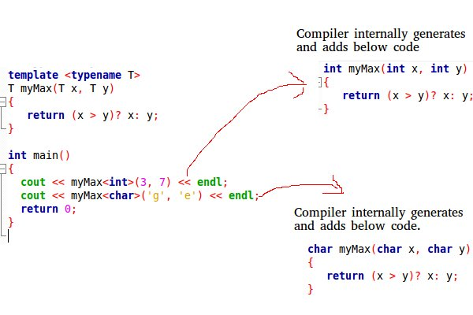
Templates
Templates are generic instructions without specific type at compile time.
During compilation a function being called using a template will insert the types of their variables into the function

Slide 4
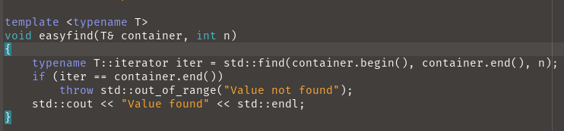
Templates
Templates can also be Classes or use a class as inserted value
They can also use these class-specific functions if they exist for the class inserted.
! If the function does not exist the compiler will throw a compilation error.

Slide 5
Containers
Container Types:
Sequence Containers
Associative Containers
Unordered Associative Containers
Container Adaptors

Slide 6
Sequence Containers
Incl.: vector, array, list, forward_list, deque
Store elements in linear sequence
Allow duplicate elements
Elements are accessed by position (index)
Insertion and deletion can occur at any position (although insertion and deletion are more efficient at the start, end)
Random access mostly possible (excl. lists)

Slide 7
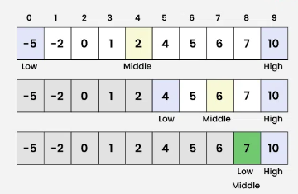
Sequence Containers
Random Access:
To access a position inside of a container without necessary iteration.

Slide 8
Sequence Containers
Common functions:
push_back(): Add element at the end
pop_back(): Remove last element
insert(): Insert elements at a specific position
erase(): Remove elements from a specific position
clear(): Remove all elements
size(): Get number of elements
empty(): Check if container is empty
front(): Access first element
back(): Access last element
begin(), end(): Iterators to first and past-the-last elements
Specific to vector and deque:
operator[]: Access element by index
at(): Access element by index with bounds checking

Slide 9
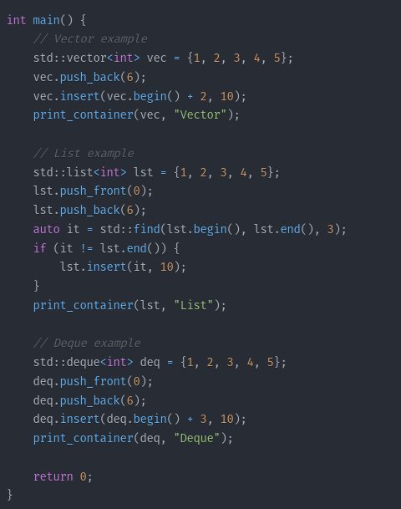
Sequence Containers
Code Examples:

Slide 10
Associative Containers
Incl.: set, multiset, map, multimap
Associate a key for each element stored
Uses key as the lookup position, making it very fast
Set, map overwrite duplicate keys
Multisets, multimaps allow multiple duplicate keys
Sets only store keys, while maps store key-value pairs
Ordered by insertion

Slide 11
Associative Containers
Associative Containers (set, multiset, map, multimap):
insert(): Insert elements
erase(): Remove elements
find(): Find an element
count(): Count occurrences of an element
lower_bound(): Return iterator to first element not less than given value
upper_bound(): Return iterator to first element greater than given value
equal_range(): Get range of elements equal to a given value
size(): Get number of elements
empty(): Check if container is empty
clear(): Remove all elements
begin(), end(): Iterators to first and past-the-last elements
Specific to map and multimap:
operator[]: Access or insert element (map only)

Slide 12
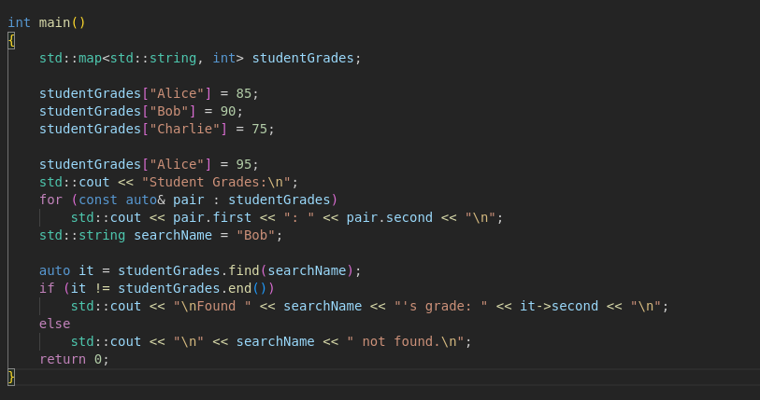
Associative Containers
Code Examples:

Slide 13
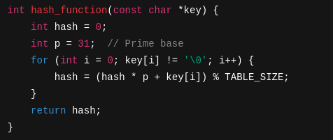
Unordered Associative Containers
Incl.: unordered_set, _multiset, _map , _multimap
Utilize Hash Table implementation giving each key a calculated value position using polynomial rolling hash functions
Example (simplified):

Slide 14
Unordered Associative Containers
Unordered Associative Containers (unordered_set, unordered_multiset, unordered_map, unordered_multimap):
insert(): Insert elements
erase(): Remove elements
find(): Find an element
count(): Count occurrences of an element
equal_range(): Get range of elements equal to a given value
size(): Get number of elements
empty(): Check if container is empty
clear(): Remove all elements
begin(), end(): Iterators to first and past-the-last elements
bucket_count(): Get number of buckets
load_factor(): Get current load factor
max_load_factor(): Get or set maximum load factor
rehash(): Set number of buckets and rehash
Specific to unordered_map and unordered_multimap:
operator[]: Access or insert element (unordered_map only)

Slide 15
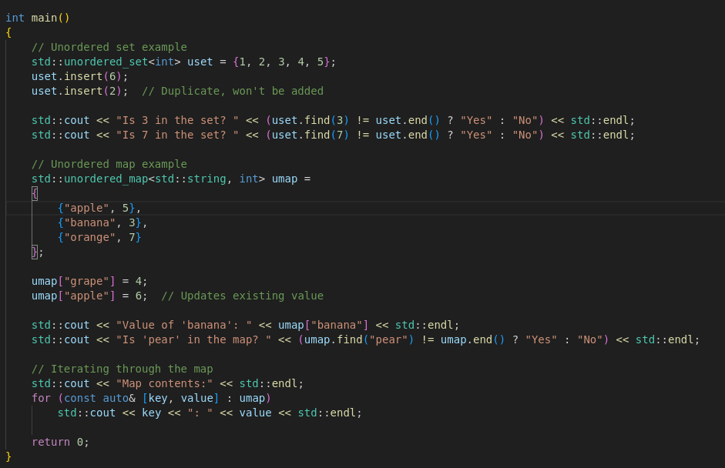
Unordered Associative Containers
Code Example:

Slide 16
Container Adaptors
Incl.: Stack, Queue, Priority_queue
Utility: Built upon different container-classes
  Provide a restricted interface to the underlying container classes
  Specific functionalities blocked from the underlying containers
Stack: Usually built on deque
  Last in – First out and only allows access to the top element
Queue: Usually built on deque
  First in – First out, meaning it only allows insertion at back and deletion from front (tail, head)
Priority_Queue: Usually built on vector
  Highest Value out first (Highest Priority)

Slide 17
Container Adaptors
Each Adapter only allows certain underlying containers to be built upon.
Example: stack allows any container supporting the following operations: back(), push_back(), pop_back()
Question: Why use these simplified containers instead of the underlying containers?

Slide 18
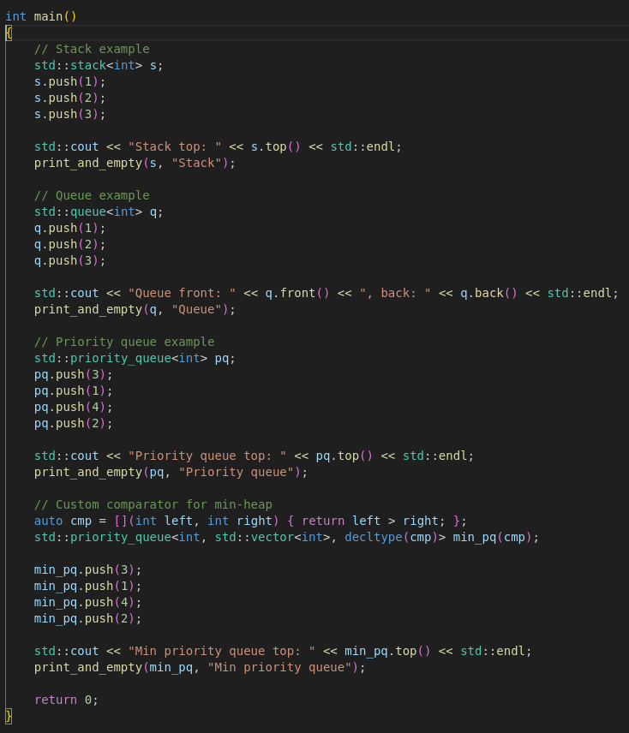
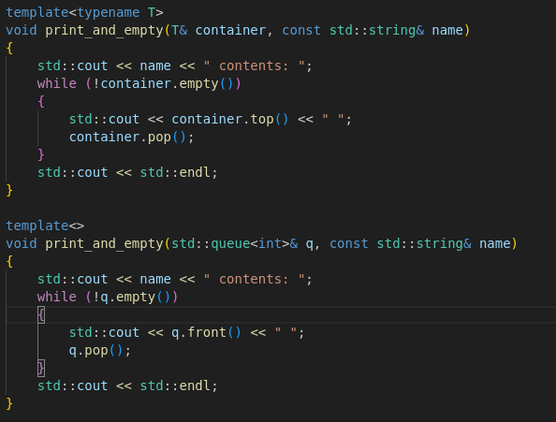
Container Adaptors
Code Examples:

Slide 19
Short Break
5-10 minutes

Slide 20
New C++11 Features
Keywords (nullptr, auto, override)
Lambda expressions
Enum class
Smart pointers

Slide 21
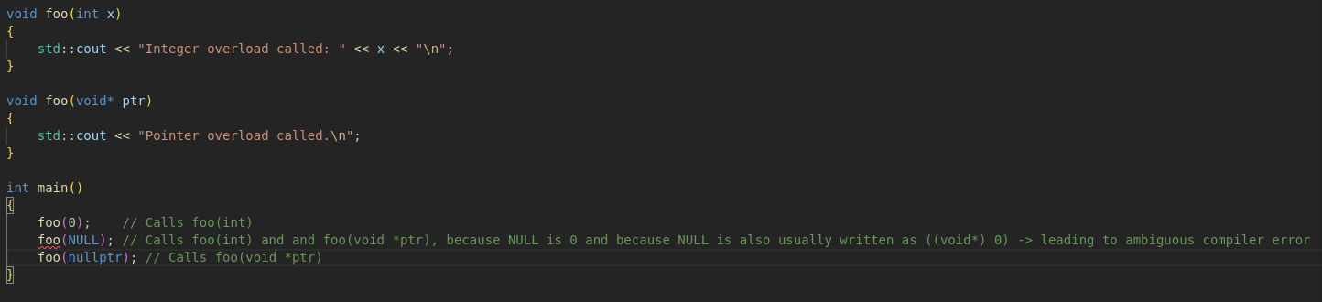
Nullptr
Replaces NULL after c++11
Improves type safety
Example:

Slide 22
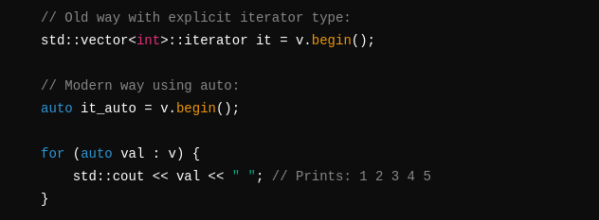
Auto
Provides type deduction by the compiler
Syntax: auto needs to be initialized at the point of declaration
Example:
Most useful when using type inference in containers
Example:

Slide 23
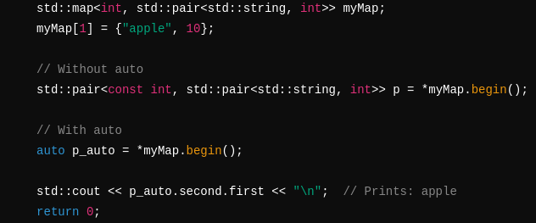
Auto
Another Example for text simplification:

Slide 24
Auto
What to look out for:
1. Const and static declaration need to be explicitly set, auto does not automatically deduce these.
Example:

Slide 25
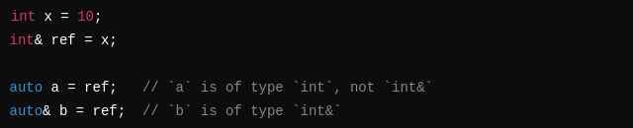
Auto
2. Decay
Decay means certain types undergo transformations
Examples:

Slide 26
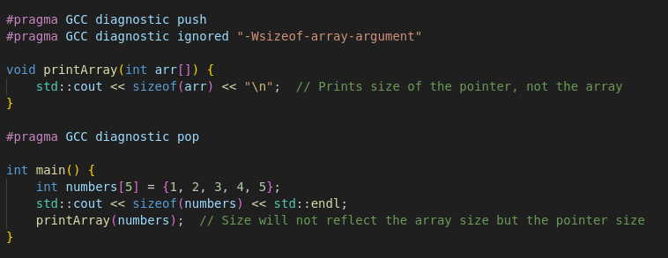
Auto
Question: What happens when I try to do sizeof(ptr) compared to arr[]?
Provide an explanation on these use cases of array decay!

Slide 27
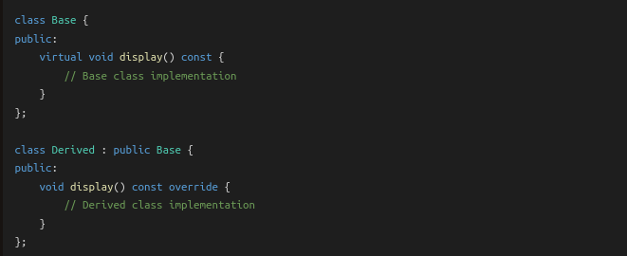
Override
New Safety Feature for Derived classes
Throws an error if there is no base class virtual function that you want to override
Syntax:

Slide 28
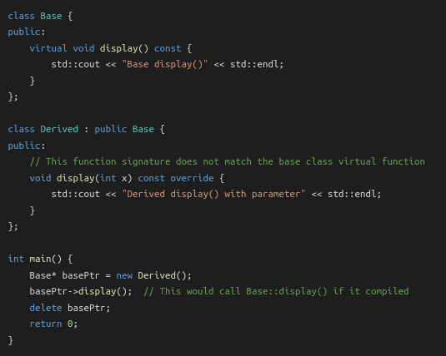
Override
So when does it throw an error?
Example:
Throws compiler error: 'void Derived::display(int) const' marked 'override', but does not override

Slide 29
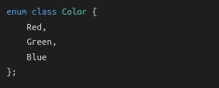
Enum Class
New Safety Feature for Enums
Also known as scoped enumeration
Syntax:

Slide 30
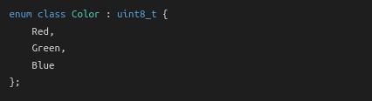
Enum Class
Strongly typed means no implicit type conversion as with enum
  enum on default was always 0 1 2 3 etc..
enum class cannot be converted implicitly
To convert you need to explicitly cast it like so:
It is possible to specify the underlying values when first declaring the enum class like so:

Slide 31
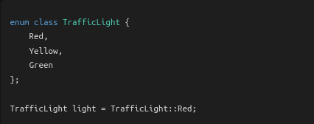
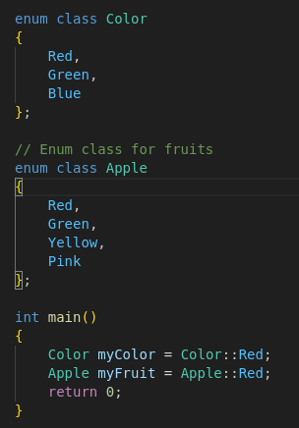
Enum Class
Benefits:
Type Safety:
Avoid Name Clashes:

Slide 32
Smart Pointers
Utility: Improved memory management
Part of the <memory> library
Consist of 3 different pointer types:
1. Unique_ptr
2. shared_ptr
3. weak_ptr
When either of these pointers lose the last occurrence of their variable
For example by going out of scope, they automatically get deleted! No need for memory management!

Slide 33
Smart Pointers
Unique_ptr:
Provides unique ownership of an allocated object/variable
Syntax:
Can only have one variable at a time holding the pointer!
To transfer ownership needs to utilize std::move(new var)

Slide 34
Smart Pointers
Unique_ptr:
What to look out for!:
  Passing the ptr to another function needs to happen by reference,
  If you want to be able to keep the result of the operations inside of the passed function,
  Otherwise a copy of the variable will be created on pass instead!
Example on next pages:

Slide 35
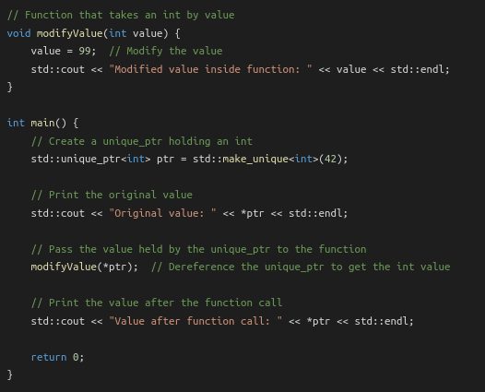

Smart Pointers
Will result in:

Slide 36
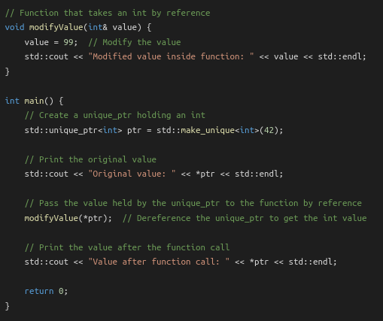

Smart Pointers
“Correct” Behaviour:
Will result in:

Slide 37
Smart Pointers
Shared_ptr:
Provides shared ownership of an object/variable
Syntax:
Shares Ownership with each other shared pointer assigned its value → This means that each change to the shared value changes the value for every shared pointer!
Example on next page:

Slide 38
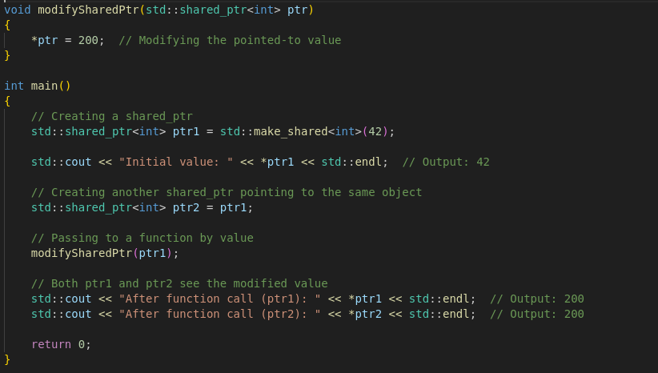
Smart Pointers
Shared_ptr example:

Slide 39
Smart Pointers
Shared_ptr:
What to look out for:
  Extended Lifetime, Cyclic references, overwriting values!
  Shared pointers will only be deleted from memory when the last occurrence of all shared pointers holding the same value go out of scope!
  If two shared pointers reference each other we can get a cyclic reference
  Overwriting values, pretty self explanatory, in tricky cases like asynchronous operations though, they can get confusing fast!
  Examples on next pages:

Slide 40
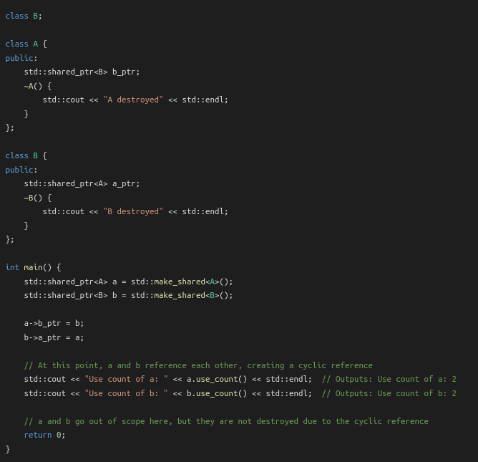
Smart Pointers
Cyclic reference:

Slide 41
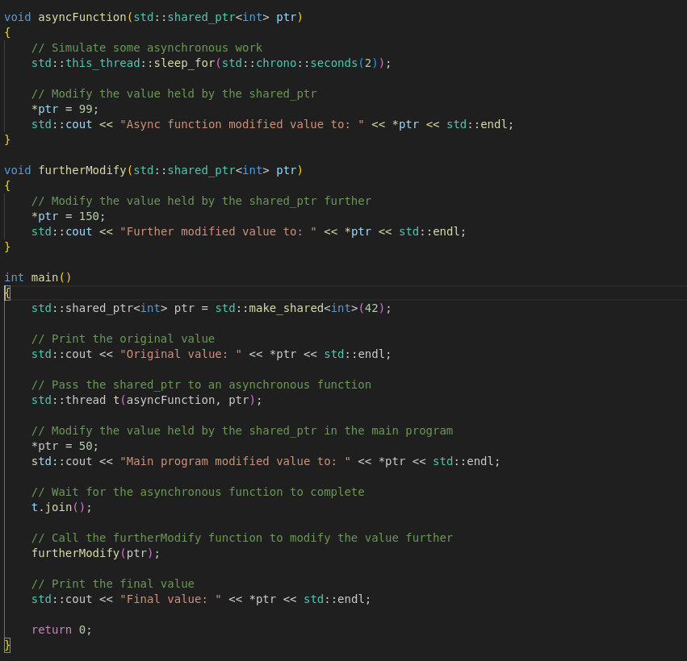
Smart Pointers
Overwriting Values:

Slide 42
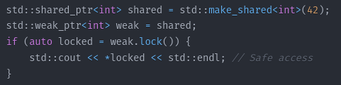
Smart Pointers
weak_ptr:
Holds a non-owning reference to an object managed by a shared_ptr
Must be converted to a shared_ptr to access the object
Syntax:
Use Case:
  To break circular references between shared_ptrs

Slide 43
Smart Pointers
Best Practices:
  1. Use unique_ptrs over shared_ptrs for exception safety and efficiency
  2. use weak_ptrs to break circular references
  3. Avoid mixing raw pointers and smart pointers for the same resource/object/var

Slide 44
Lambda Expressions
Also known as closures are anonymous functions
Syntax: [capture](parameters) → return_type
{
function body
}
Typically used with STL algorithms like std::sort etc..

Slide 45
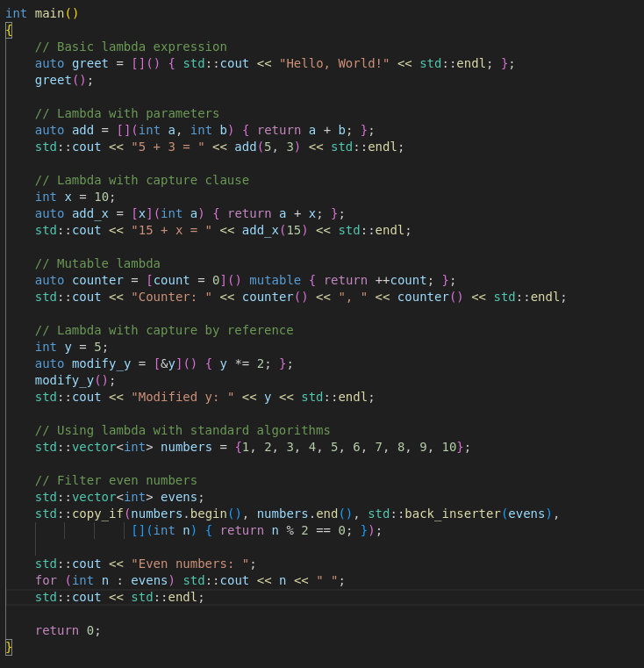
Lambda Expressions
Code Examples:

Slide 46
Short Break
5-10 minutes

Slide 47
New C++ 11 Libraries
A look into:
Chrono - Time Library
Thread – MultiThreading Library
Mutex – Mutex Library
Condition_variable – condition variables Library
Atomic – Atomic operations
Future – Asynchronous Library
Regex – Regular expressions

Slide 48
Chrono
#Include <chrono>
Main Components:
  Durations
  Time points
  Clocks
Namespace: std::chrono

Slide 49
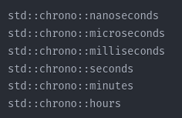
Chrono
Durations:
Duration casting syntax:

Slide 50


Chrono
Timepoints are a combination of clock and duration, represented by the std::chrono::time_point template
Examples:
ex. Now < later

Slide 51
Chrono
Clocks: represent different time measurement tools that can measure time differently
Chrono uses 3 different clocks:
  std::chrono::system_clock wall clock time
  std::chrono::steady_clock monotonic clock (never adjusted)
  std::chrono::high_resolution_clock highest precision clock
Each come with their own benefits and drawbacks (performance, accuracy etc..)

Slide 52

Chrono
Chrono also supports conversion from and to other time formats such as time_t for example.

Slide 53
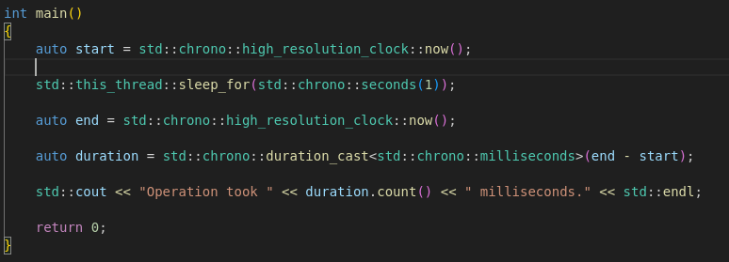
Chrono
Code example:

Slide 54
Thread
Include <thread>
Components:
  Std::thread class
  Std::this_thread namespace
  Std::thread::id type

Slide 55
Thread
Std::Thread:
Classic Thread representation
Can be initialized in multiple different ways using functions, functors(function objects) and lambda expressions.
Classic join, detach functionality calling .join or .detach on the thread class object
Also implements condition checks for error management.
Example: Always call thread.joinable() to check if join can be called!
Beware the threads will be automatically deleted once the function goes out of scope, so a call to join() or detach() is necessary or the program terminates!

Slide 56
Thread
Std::this_thread namespace:
Hand the thread class core functionalities like:
  get_id() returns the id of the current thread
  Yield() suggests reschedule of thread execution
  sleep_for() blocks calling thread for duration
  sleep_until() blocks calling thread until time_point

Slide 57
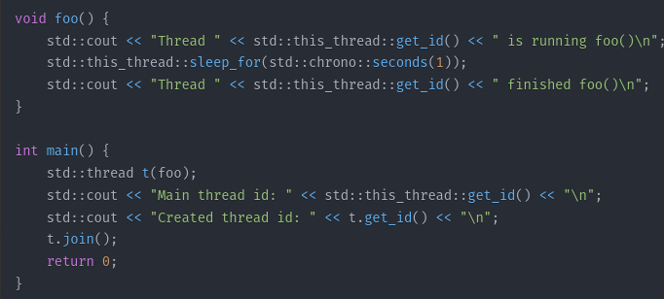
Thread
Example:

Slide 58
Mutex
Include <mutex>
Components:
  Mutex Types
    Mutex
    timed_mutex
    (I will exclude recursive mutexes and timed recursive mutexes)
  Lock Types
    lock_guard
    unique_lock

Slide 59
Mutex
Std::mutex
Classic mutex representation
Requires manual lock / unlocking
Can cause deadlocks just like in C
Created using: std::mutex <name>
Functionality:
  mutex.lock() → classic lock
  mutex.try_lock() → attempts locking, in case of failure returns immediately
  mutex.unlock() → classic unlock

Slide 60
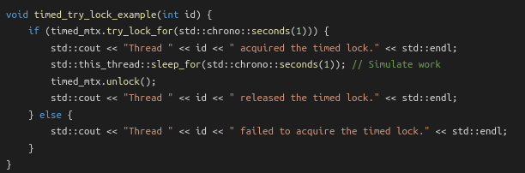
Mutex
Std::timed_mutex
Timed mutex
Requires manual lock / unlocking
Compared to normal mutex → can unlock after certain time
  No deadlocks
Created using: std::timed_mutex <name>
Functionality:
  mutex.lock() → classic lock
  timed_Mutex.try_lock() → attempts lock, in case of failure immediately returns
  timed_mutex.try_lock_for(duration) → attemps locking until duration is over then returns in case of failure
  timed_mutex.try_lock_until(timepoint) → attempts lockung until reaching timepoint, then returns in case of failure
  mutex.unlock() → classic unlock

Slide 61
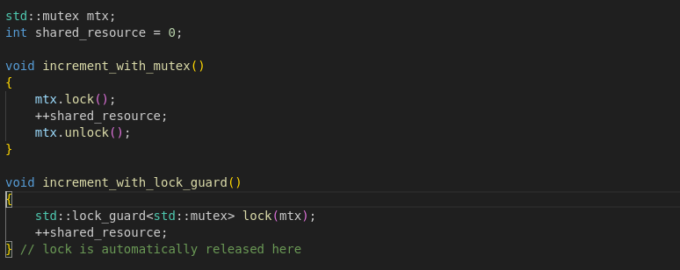
Mutex
Std::lock_guard
Used in combination with a mutex, automatically unlocks
a mutex once it goes out of scope.
Simplifies syntax and code clarity
Syntax: std::lock_guard<std::mutex> lockvar(“mutexvar”)
Example:

Slide 62
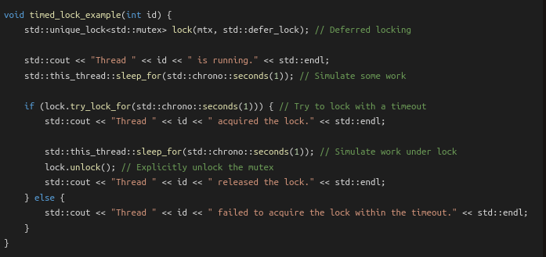
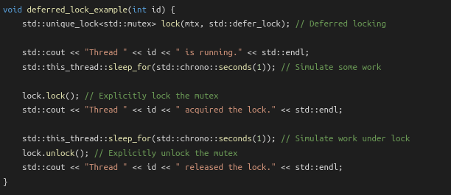
Mutex
Std::unique_lock
Just like lock_guard, automatically unlocks a mutex once it goes out of scope.
Can apply timed locking onto any kind of mutex
Can defer locking until a later date
Syntax: std::unique_lock<std::mutex> lockvar(“mutexvar”)
Examples:

Slide 63
Condition_variable
#include <condition_variable>
Components:
  Std::condition_variable
  Provide additional support to mutexes && locks
  Main operations:
    Wait(lock) → puts calling thread to sleep and unlocks mutex. Reacquires lock on wake up notification.
    Wait(lock, condition) → puts calling thread to sleep and unlocks mutex, wakes up on evaluating condition to true
    notify_one() → Wakes up any one waiting thread
    notify_all() → wakes up all waiting threads
    wait_for(lock, duration) → waits for notification for a specified duration
    wait_until(lock, time_point) → wait for notification until a specific time point

Slide 64
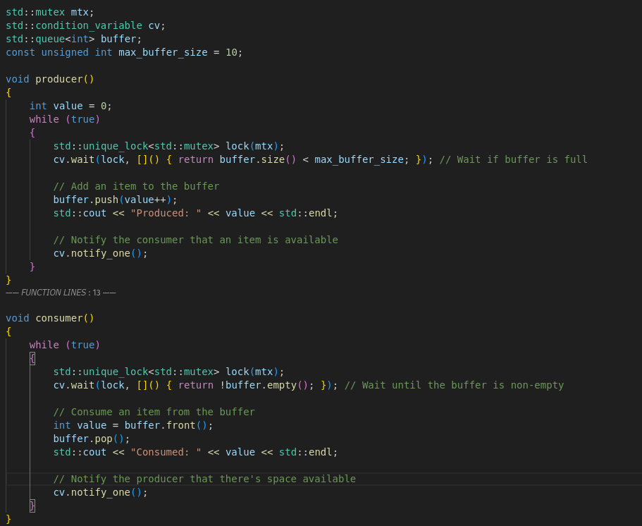
Condition_variable
Example Usage:

Slide 65
Atomic
#include <atomic>
What are atomic operations?
Std::atomic
Std::atomic functions

Slide 66
Atomic
What are atomic operations?
  Atomic operations perform a single indivisible step
    Meaning they cannot be interrupted by other threads in a multithreaded application
    Meaning they are thread safe operations with which you can for example increment a value without needing mutexes
    Also more efficient than mutexes in terms of performance, since they are implemented using low level hardware-instructions like CAS(Compare and swap), Test-and-Set and LL/SC(Load-link/store-conditional)

Slide 67
Atomic
Std::atomic
Can be used to make primitive types like: integers,pointers etc.. atomic
Declaration syntax: std::atomic<type> var(value)
Provided features are:
  Loads
  Stores
  fetch_operations
  compare_operations
  memory_ordering (will skip this)
  Specialized atomic types like std::atomic flag (will also skip this)

Slide 68
Atomic
Load()
Syntax: int val = atomic_var.load()
Atomically reads values
Store()
Syntax: atomic_var.store(5)
Atomically stores values

Slide 69
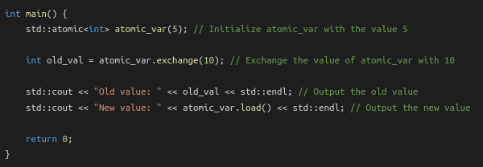
Atomic
exchange():
Syntax: int old_val = atomic_var.exchange(10)
Atomically exchanges the values, basically performing a swap
Also has other exchanges (compare_exchange_weak and compare_exchange_strong)

Slide 70
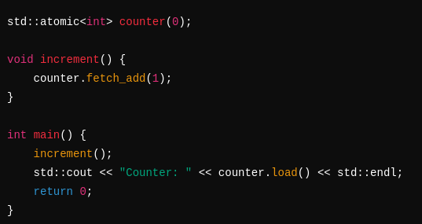
Atomic
fetch_operations:
Syntax: atomic_var.fetch_add(val)/_sub(val)/_and(val)/_or(val)/_xor(val)
Atomically adds, subtracts, uses bitwise and/or/xor operations

Slide 71
Future
#include <future>
What are futures?
Components:
Std::future
Std::promise
Std::async
Std::shared_future (will skip this)
Std::packaged_task (will also skip this)

Slide 72
Future
What are Futures?
  Futures provide a way to handle asynchronous operations
  What are asynchronous operations?
    Asynchronous operations are routines executed independantly of the running program
    They are useful to delegate processing intensive operations to run concurrent to the active program such as I/O operations, network requests or complex calculations.
    Once the result of the operation is required it can be requested from the asynchronous operation

Slide 73
Future
What are Futures?
  Imagine a scenario where you main program needs to wait and accept requests it gets sent, but also needs to process these requests and send answers.
  Traditionally you would spawn threads or child processes that handle these requests
  Now if I had thousands or even millions of requests your CPU and even big data servers would need an incredible amount of resources just to manage all these running threads and processes
  Asynchronous programming models use event-driven programming which improve the scalability, resource efficiency, responsiveness, and utilization of I/O resources since they don’t block like waiting threads or processes.

Slide 74
Future
So how do we use Futures?
Std::future:
  Read-only handle to a result of an async operation
  Allways paired with std::promise or created by std::async
Std::promise
  Write-only handle used to set a value for a std::future
  This is the producer of a value while future is the consumer

Slide 75
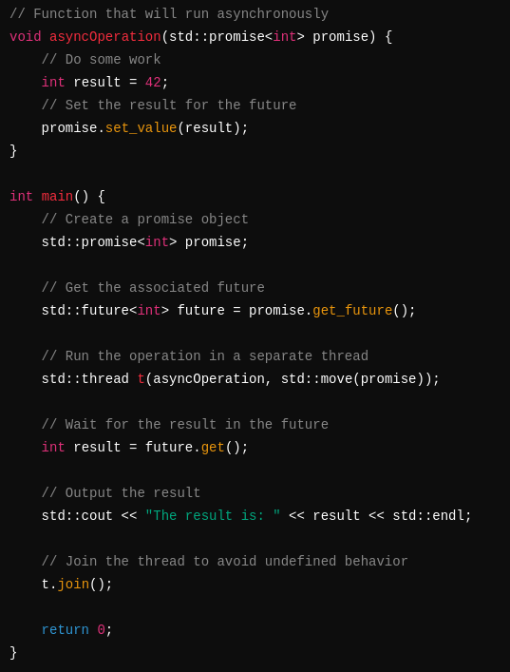
Future

Slide 76
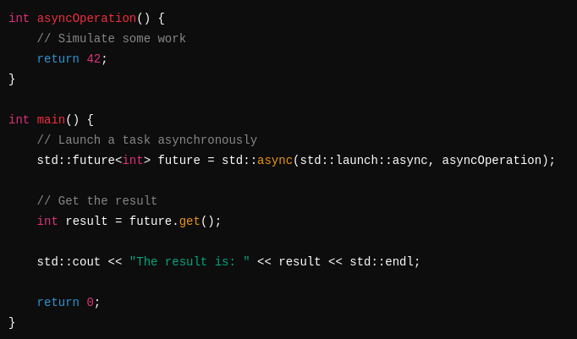
Future
So how do we use Futures?
Std::Async
  Launches an asynchronous operation, simplifying the promise/future logic

Slide 77
Regex
#include <regex>
What are regular expressions?
Components:
  Regular expression support
  That’s it

Slide 78
Regex
What are regular expressions?
  Regular expressions are a pattern matching tool used for string matching, text search and replace, input validation and data extraction
Basic regex patterns:
. : Matches any character except newline
^ : Matches the start of a string
$ : Matches the end of a string
* : Matches 0 or more repetitions
+ : Matches 1 or more repetitions
? : Matches 0 or 1 repetition
\d : Matches any digit (0-9)
\w : Matches any alphanumeric character
\s : Matches any whitespace character

Slide 79
Regex
Common regex functions and functor:
  regex_match() → checks if an entire string matches a regex
  regex_search() → searches for a regex match inside a string
  regex_replace() → replaces regex matches in a string
  sregex_iterator() → functor to iterate over regex matches

Slide 80
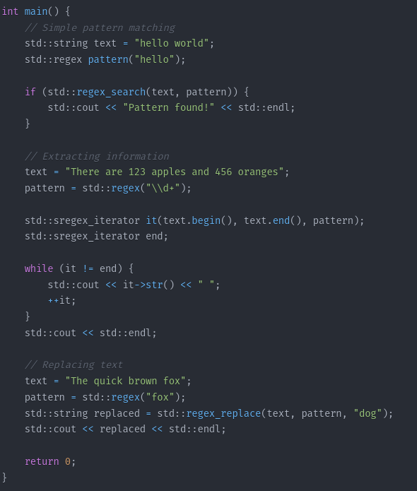
Regex
Examples:

Slide 81
Thank you for watching

